Slide 1
COMP 469 · INTRODUCTION TO ARTIFICIAL INTELLIGENCE
Informed Search
& Heuristic Functions
Russell & Norvig, Artificial Intelligence: A Modern Approach — Sections 3.5 and 3.6
CSU Channel Islands · Two-hour lecture
COMP 469 · AIMA 3.5–3.6
1
Notes:
[0:00-0:02] Opening.
Frame the whole session in one sentence: last time we searched blind, today we search with a hint. Everything in 3.5 and 3.6 is about one question - how do you build and use a good hint?
Session plan: ~50 min on 3.5, 10 min break, ~45 min on 3.6, 10 min wrap-up and Q&A.
Two in-class checkpoints are built in (slides 19 and 43) - use them as pacing valves. If you are running long, checkpoint 2 can be assigned rather than worked.

Slide 2
ROADMAP
Where we are going
PART 1 · 3.5 INFORMED SEARCH
PART 2 · 3.6 HEURISTIC FUNCTIONS
Heuristic functions and the Romania map
Greedy best-first search
A*: admissibility, consistency, the optimality proof
Search contours and optimal efficiency
Satisficing search and weighted A*
Memory-bounded search: beam, IDA*, RBFS, SMA*
Bidirectional heuristic search
The 8-puzzle: h1 and h2
Measuring heuristic quality: effective branching factor
Domination
Generating heuristics from relaxed problems
Pattern databases and disjoint pattern databases
Landmarks and differential heuristics
Learning to search, and learning heuristics
Break at the halfway point, after the A* optimality material. Two checkpoint exercises are built into the session.
COMP 469 · AIMA 3.5–3.6
2
Notes:
[0:02-0:04] Roadmap.
Set expectations: Part 1 is about algorithms that USE a heuristic. Part 2 is about where heuristics COME FROM. Students often treat 3.6 as optional detail - stress that 3.6 is the part that actually makes A* usable on real problems, and it is the part that shows up in applied work (route planning, puzzle solvers, planners).
Tell them the single organizing equation for the day is f(n) = g(n) + h(n), and that almost every algorithm today is obtained by changing how much you trust g versus h.

Slide 3
WHERE WE LEFT OFF
Recap: every search we have seen is a best-first search
Best-first search repeats one step: pop the frontier node with the lowest evaluation function f(n), expand it, push its children. The only thing that separates the algorithms in 3.4 is the choice of f.
Algorithm
Evaluation function f(n)
Knowledge used
THE SHIFT
Breadth-first search
depth(n)
Problem definition only
Uninformed search asks only: how far have I come?
Informed search also asks: how far do I still have to go?
That question cannot be answered from ACTIONS and RESULT.
Uniform-cost search
g(n) — cost so far
Problem definition only
Depth-first search
−depth(n)
Problem definition only
Greedy best-first
h(n)
+ domain knowledge
A* search
g(n) + h(n)
+ domain knowledge
Nothing about the best-first machinery changes today. Only f changes — and that one change buys orders of magnitude.
COMP 469 · AIMA 3.5–3.6
3
Notes:
[0:04-0:08] Recap and framing.
Ask the room to reconstruct the best-first loop from memory before you reveal the table. It takes 60 seconds and it anchors everything that follows.
Key point to land: BFS, UCS, DFS, greedy, and A* are one algorithm with five different f functions. Students who see this stop memorizing five algorithms and start reasoning about one.
Also remind them of the two things they already know that we will lean on hard today: (1) the goal test happens when a node is popped for expansion, not when it is generated; (2) the reached table is what makes graph search terminate.

Slide 4
PART 1
3.5 Informed
(Heuristic) Search
Domain-specific hints about where the goal is, and the algorithms that exploit them.
COMP 469 · AIMA 3.5–3.6
4
Notes:
[0:08] Transition slide. Keep it to ten seconds — the content starts on the next slide.

Slide 5
3.5 · DEFINITIONS
The heuristic function
h(n) = estimated cost of the cheapest path from the state at node n to a goal state
WHAT IT IS
WHERE IT COMES FROM
THE CANONICAL EXAMPLE
An estimate, not a guarantee
Non-negative, and h = 0 at a goal
Cheap to compute (that is the point)
Domain-specific
Outside the problem definition
Not derivable from ACTIONS / RESULT
Requires world knowledge
Section 3.6 is entirely about this
Route finding: use the straight-line distance between two points on the map.
We call it hSLD.
A ruler and a map give you something the road network alone does not.
It takes world knowledge to know that straight-line distance correlates with road distance. The problem definition never says so.
COMP 469 · AIMA 3.5–3.6
5
Notes:
[0:08-0:12] The heuristic function.
Emphasize the word ESTIMATED. Students routinely slip into treating h as the true remaining cost; every confusion later in the lecture traces back to that slip.
Push on the third card. Ask: could a program compute hSLD from the ACTIONS and RESULT functions of the Romania problem? No - the problem definition contains roads and costs, not coordinates. Somebody had to supply latitude and longitude, and somebody had to know that Euclidean distance is a sensible proxy for driving distance. That is the 'domain-specific hint' the textbook keeps referring to.
Good aside: a heuristic that is expensive to compute can be worse than no heuristic. We will make that precise on the domination slide in Part 2.

Slide 6
3.5 · A SECOND EXAMPLE
Heuristics for a problem with no geometry
Straight-line distance makes a heuristic look like a fact about maps. It is not. Sorting a stack of pancakes with a spatula is a search problem too, and it has heuristics of its own.
THE PROBLEM
TWO ADMISSIBLE HEURISTICS
Four pancakes of different sizes. The goal is the sorted stack, largest on the bottom.
Action: slide a spatula under some pancake and flip everything above it.
Cost: the number of pancakes moved by that flip.
State space: 4! = 24 stacks, and three useful spatula positions from any of them.
Count out of place — every misplaced pancake must move at least once, and every flip moves at least one pancake.
Largest out of place — fixing pancake k means flipping the whole stack down to it, so at least k pancakes must move.
The second is usually the larger number, and the more precise estimate.
Designing a heuristic is an art form. The same problem admits several, they need not be comparable, and the good ones all come from asking what every solution must do at minimum.
COMP 469 · AIMA 3.5–3.6
6
Notes:
[0:12-0:15] Pancake flipping. NOTE ON TIMING: this slide and the next add roughly six minutes to Part 1. If you are running to the original schedule they are the first two to cut, and both survive being assigned as reading.
Why it is here: after Romania, students quietly conclude that a heuristic is a distance. It is not. It is a lower bound on remaining work, and work need not be spatial.
Run the state space out loud: 4 choices for the bottom pancake, 3 for the next, then 2 and 1, so 24 stacks. Note that inserting the spatula between the top two pancakes does nothing useful, which leaves three real actions.
Both heuristics are worth justifying properly, because the justification is the same move they will make all semester: name something every solution must do, then count it. Every misplaced pancake has to move at least once. Any solution that fixes pancake k has to disturb everything sitting above it.
Fun aside if you want it: pancake sorting is a real result, and the paper was co-authored by Bill Gates and Christos Papadimitriou.

Slide 7
3.5 · DESIGN RULES
Three rules before you write h(n)
Admissibility and consistency are the theory. These three are the hygiene, and they are what actually goes wrong first.
MATCH THE ACTION SET
READ ZERO AT THE GOAL
SCALE TO COST UNITS
Pac-Man moves north, east, south and west only, so Manhattan distance is the right metric.
Euclidean distance is admissible too, but sits further below the truth on every state, and a looser bound is a weaker heuristic.
Aim for the exact cost of moving under a relaxed version of your own action set.
h must measure distance from the goal, not closeness to it.
Counting correctly ordered pancakes rises as you approach the goal. Use 4 minus the longest ordered run instead.
A heuristic that is non-zero at a goal state cannot be admissible.
h is added to g inside f = g + h, so the two must be denominated in the same thing.
A heuristic that counts moves is meaningless when actions cost kilometres.
Rescale, or redefine, until h and g are commensurable.
None of this is theory, and all of it is failure mode: nearly every broken A* in a student project breaks one of these three before it ever gets near admissibility.
COMP 469 · AIMA 3.5–3.6
7
Notes:
[0:15-0:18] Heuristic design hygiene.
Rule 1 is the one with the most transfer. The question is never 'what distance function do I know', it is 'what does one step of my agent actually cost'. Euclidean distance on a four-connected grid is a real example of a heuristic that is admissible and still bad: it is correct and systematically too small, so it prunes less.
Rule 2 catches the most common student bug. They write a heuristic that scores progress rather than remaining work, and it points the search the wrong way. The tell is trivial to check: evaluate h at a goal state and confirm it is zero.
Rule 3 sounds obvious and is not. On the Romania map, g is in kilometres. A heuristic returning 'number of cities remaining' is a perfectly sensible quantity and completely useless inside f, because it is a hundred times too small to influence the sum.
If you are short on time, state rule 2 and move on. It is the only one that shows up as a bug rather than as mediocre performance.

Slide 8
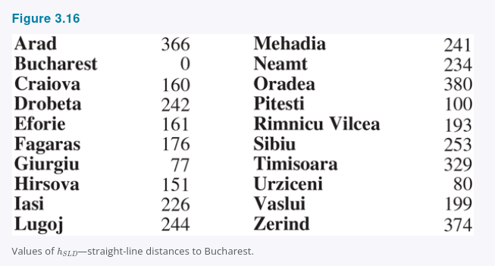
FIGURE 3.16
The Romania map and hSLD
READ IT THIS WAY
Left: the road network, with actual road costs
Right: straight-line distance to Bucharest for every city
hSLD(Arad) = 366
hSLD(Bucharest) = 0
These numbers come from a ruler, not from the graph
Goal for the next 30 minutes: get from Arad to Bucharest, and understand exactly why two algorithms using the same numbers give different answers.
COMP 469 · AIMA 3.5–3.6
8
Notes:
[0:12-0:14] Figure 3.16.
Have students find three numbers on the slide before you move on: the road cost Arad-Sibiu (140), hSLD(Sibiu) (253), and hSLD(Arad) (366). Those three numbers are all they need to follow both traces coming up.
Note the discrepancy out loud: hSLD(Arad) = 366 but the actual optimal road distance from Arad to Bucharest is 418. The heuristic is an underestimate here - hold that thought, it becomes 'admissibility' in about fifteen minutes.

Slide 9
3.5.1
Greedy best-first search
f(n) = h(n)
THE GAMBLE
Greedy search bets that a good local estimate implies a good global path. That bet pays off in speed and loses in quality — the algorithm has no way to notice that it is taking an expensive route to a nearby-looking place.
Always expand the node that looks closest to the goal. Path cost so far is ignored entirely.
The intuition: if a node looks close, going there is probably a fast route to a solution.
COMPLETE
Yes in finite spaces
COMPLETE
No in infinite spaces
COST-OPTIMAL
No
WORST CASE TIME & SPACE
O(|V|)
With a good heuristic the complexity can drop substantially — on some problems as far as O(bm).
COMP 469 · AIMA 3.5–3.6
9
Notes:
[0:14-0:17] Greedy best-first search.
Definition first, properties second, trace third. Do not let the trace come before the definition or students memorize the picture instead of the rule.
The completeness distinction matters: in a finite state space with a reached table, greedy graph search cannot loop forever because it eventually runs out of states. In an infinite space it can chase a heuristic downhill forever - the classic example is a map where h decreases as you drive down a road that never reaches the goal.
Worst case is O(|V|) because in the pathological case you expand every vertex. Note that |V| here, not b^d - we are in graph search with a reached table.

Slide 10
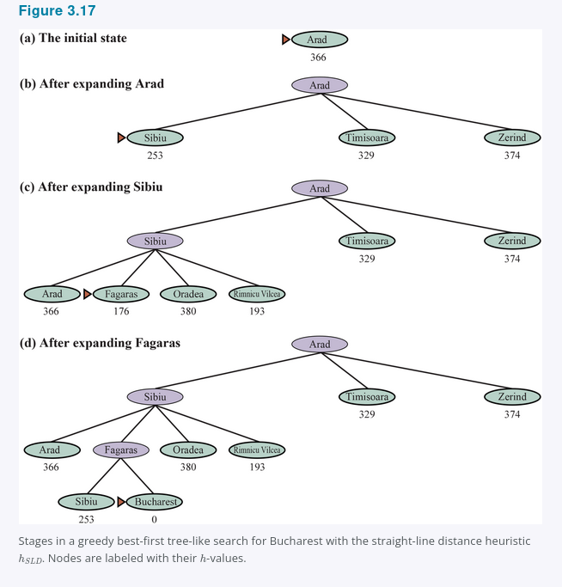
FIGURE 3.17
Greedy search from Arad to Bucharest
THE TRACE
Expand Arad → Sibiu (253) beats Timisoara (329) and Zerind (374)
Expand Sibiu → Fagaras (176) is now the smallest h
Expand Fagaras → generates Bucharest (0), the goal
Not a single node off the solution path was ever expanded
450
418
+32
cost of the greedy path
Arad–Sibiu–Fagaras–Bucharest
cost of the optimal path
via Rimnicu Vilcea and Pitesti
miles of avoidable detour
COMP 469 · AIMA 3.5–3.6
10
Notes:
[0:17-0:21] Figure 3.17 walkthrough.
Walk the four panels on the board or by pointing. At each step ask the room which node has the smallest h before you reveal the answer.
The punchline is the number pair at the bottom right: greedy found a solution fast and it found the WRONG one. Ask why the algorithm never even considered Rimnicu Vilcea seriously - because hSLD(Rimnicu Vilcea) = 193 is larger than hSLD(Fagaras) = 176, and greedy looks only at h. The 80 miles already spent getting to Sibiu are invisible to it.
This is a good moment for the name: 'greedy' means each iteration grabs the locally best-looking option, and greediness can do worse than being careful.

Slide 11
3.5.2
A* search
f(n) = g(n) + h(n)
g(n)
h(n)
start
n
goal
known — cost already paid
estimated — cost still to come
f(n) = estimated cost of the best solution path that continues through n. Uniform-cost search is A* with h = 0; greedy best-first is A* with g ignored.
A* is complete. Whether it is cost-optimal depends entirely on properties of h — which is the subject of the next four slides.
COMP 469 · AIMA 3.5–3.6
11
Notes:
[0:21-0:25] A* search.
The diagram is the whole idea: g is measured, h is guessed, and f adds them into an estimate of the total. The dashed arrow on the h side is deliberate - it is the part we do not actually know.
Stress the reduction: set h = 0 and A* is uniform-cost search; ignore g and A* is greedy best-first. A* is not a new algorithm so much as the balanced point between the two we already know.
Flag clearly that A* is ALWAYS complete but only CONDITIONALLY optimal. Students conflate the two constantly on exams.

Slide 12
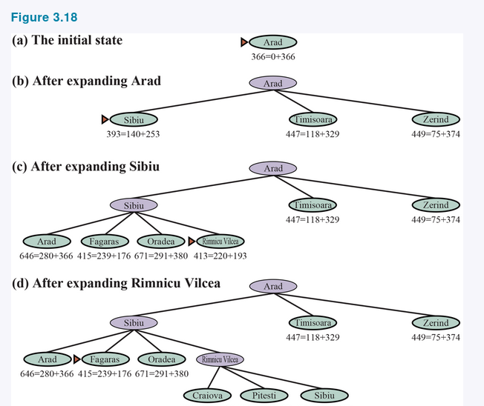
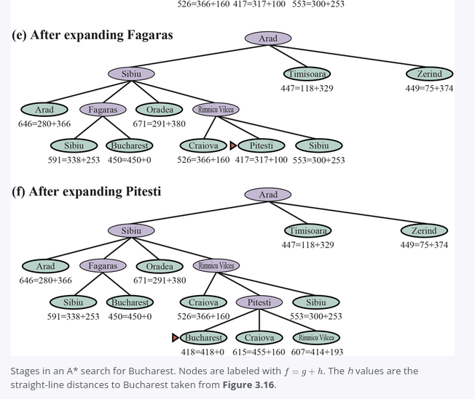
FIGURE 3.18 · STEPS (A) THROUGH (F)
A* from Arad to Bucharest
g values come from the road costs in Figure 3.1; h values are hSLD from Figure 3.16. Each node is labelled f = g + h.
COMP 469 · AIMA 3.5–3.6
12
Notes:
[0:25-0:30] Figure 3.18 walkthrough. Budget real time here — this is the single most important figure in the chapter.
Work left column then right column. At each step, state the frontier and ask which node has the lowest f.
(a) Arad, f = 366.
(b) Sibiu 393, Timisoara 447, Zerind 449. Expand Sibiu.
(c) Rimnicu Vilcea 413 beats Fagaras 415. Expand Rimnicu Vilcea.
(d) Pitesti 417 appears; Fagaras 415 is smaller, so Fagaras is expanded next.
(e) Fagaras generates Bucharest at f = 450 — and A* does NOT stop.
(f) Pitesti (417) is expanded, generating Bucharest at f = 418, which is now the minimum and is returned.
Note that Timisoara (447) and Zerind (449) sit on the frontier the whole time and are never expanded. Come back to this on the pruning slide.

Slide 13
WHY A* DOES NOT STOP EARLY
The moment that matters: step (e)
At step (e), Bucharest — the goal — is sitting on the frontier. A* refuses to return it. Understanding why is understanding A*.
450
417
418
Bucharest via Fagaras
appears on the frontier
but Pitesti is cheaper,
so Pitesti is expanded first
a different path to Bucharest —
selected, and optimal
A node on the frontier is a promise, not a solution. Bucharest at 450 only promises "a solution costing 450 exists."
Pitesti at 417 promises "there may be a solution through here costing as little as 417." A* will not settle for 450 until that promise is ruled out.
This is exactly why the goal test happens on expansion (when a node is popped), never on generation.
COMP 469 · AIMA 3.5–3.6
13
Notes:
[0:30-0:33] The critical insight. If students remember one slide from Part 1, make it this one.
Ask directly: 'we generated the goal at step (e) — why not return it?' Let someone answer. The answer you want is that f = 450 is only an upper bound on what that particular path costs, while Pitesti's f = 417 is a lower bound on what a path through Pitesti could cost. Since 417 < 450, a better solution might still be out there.
Then make the implementation point explicit: an early goal test (checking on generation) breaks A*'s optimality. This is a classic exam question and a classic bug in student code. Breadth-first search can get away with an early goal test on unit costs; A* cannot.
Felner (2018) discusses how implementations change when an early goal test is used — worth mentioning for anyone implementing this in the project.

Slide 14
3.5.2 · WHEN IS A* OPTIMAL?
Admissibility
h(n) ≤ h*(n) for every node n
IS hSLD ADMISSIBLE?
Yes. The shortest path between two points is a straight line, so no road route can ever be shorter than the straight-line distance.
This is the pattern for proving admissibility in general: show that the heuristic is the exact cost of a problem that is strictly easier than the real one.
Section 3.6 turns that pattern into a recipe.
An admissible heuristic never overestimates the cost to reach a goal, where h*(n) is the true cost of the optimal path from n to the nearest goal.
An admissible heuristic is therefore optimistic.
With an admissible heuristic, A* is cost-optimal.
Two heuristics that are always admissible and always useless:
h(n) = 0 for all n — A* degenerates to uniform-cost search.
h(n) = h*(n) — perfect, but computing it means solving the problem.
COMP 469 · AIMA 3.5–3.6
14
Notes:
[0:33-0:36] Admissibility.
Get the direction of the inequality right on the board and say it out loud twice: h must be LESS than or equal to the truth. Students flip this constantly. The mnemonic that sticks: an admissible heuristic is an optimist - it always thinks the goal is closer than it really is.
The two degenerate cases at the bottom are worth a minute. They bracket the useful range: h = 0 is admissible and gives you no help at all; h = h* is admissible and gives you a perfect search, but you cannot compute it. Every real heuristic lives between these, and 3.6 is about climbing from the bottom toward the top without paying too much per node.
Next slide is the proof — tell them it is short and worth following line by line.

Slide 15
3.5.2 · PROOF BY CONTRADICTION
Proof: with an admissible h, A* returns a cost-optimal path
Suppose not. Let C* be the cost of the optimal path, and suppose A* returns a path of cost C > C*. Then some node n on the optimal path was never expanded — because if every node on the optimal path had been expanded, we would have returned it.
Justification
f(n) > C*
otherwise n would have been expanded
f(n) = g(n) + h(n)
by definition of f
f(n) = g*(n) + h(n)
because n lies on an optimal path, so g(n) is optimal
f(n) ≤ g*(n) + h*(n)
by admissibility, h(n) ≤ h*(n)
f(n) ≤ C*
by definition, C* = g*(n) + h*(n) for n on an optimal path
Line 1 says f(n) > C*. Line 5 says f(n) ≤ C*. Contradiction — so A* never returns a suboptimal path.
Note where admissibility is used: line 4, and only line 4. Remove it and the argument collapses.
COMP 469 · AIMA 3.5–3.6
15
Notes:
[0:36-0:41] The optimality proof.
Do this on the board in parallel with the slide. Five lines, roughly one minute each.
Setup students often miss: the existence of an unexpanded n on the optimal path. Justify it explicitly — if A* had expanded every node on the optimal path, the optimal goal node would have been reached and its f value would have been C*, which is less than C, so it would have been selected first.
Line 3 deserves emphasis: g(n) = g*(n) because n is on an optimal path, and A* reached it along that path. If the heuristic is inconsistent this needs more care (we may have reached n suboptimally), which is one motivation for the consistency condition coming next.
Close by pointing at the last line on the slide: the entire proof rests on one inequality. Any heuristic that violates h ≤ h* anywhere on the optimal path puts optimality at risk.

Slide 16
3.5.2 · AN ALTERNATIVE PROOF
The same theorem, argued from the goal nodes
The previous proof reasons about an unexpanded node on the optimal path. This one reasons about two goal nodes instead. Same theorem, and some students find it far easier to reconstruct under exam conditions.
Let A be an optimal goal node and B a suboptimal one. Claim: A is expanded first.
1. If B is on the frontier, so is some ancestor n of A
otherwise A itself would already have been expanded
2. f(n) = g(n) + h(n) ≤ g(A)
by admissibility — h(n) is at most the true remaining cost, which is g(A) − g(n)
3. g(A) = f(A)
because h = 0 at any goal state
4. f(A) < f(B)
because g(A) < g(B), and both goal nodes have h = 0
5. f(n) ≤ f(A) < f(B)
so n is expanded before B — repeat for each ancestor in turn and A itself precedes B
Admissibility is used exactly once, in step 2 — the same single point of failure as line 4 of the proof on the previous slide.
COMP 469 · AIMA 3.5–3.6
16
Notes:
[0:41-0:44] The goal-node proof. Optional if you are on schedule; valuable if the contradiction proof did not land.
This is the Berkeley formulation. The two proofs are the same argument seen from opposite ends: the AIMA version asks what must be true of a node A* failed to expand, this version asks what must be true of a goal A* has not yet returned.
Step 1 is the step students skip. Say it slowly: the frontier always contains at least one node on the path to any state not yet expanded, otherwise there would be no way left to reach it.
Be honest about the gap, because a sharp student will find it. Showing f(n) < f(B) for one ancestor does not by itself finish the argument; you need the chain, applied to each successive ancestor, and the fact that expansion happens in order of f. The full write-up is in the textbook.
Two riders worth stating. First, set h = 0 and this proof also establishes that uniform-cost search is optimal, as a degenerate case. Second, this is a tree-search argument: it assumes g(n) along the path is optimal. Buying that assumption in graph search is exactly what consistency is for, which is where the next two slides go.

Slide 17
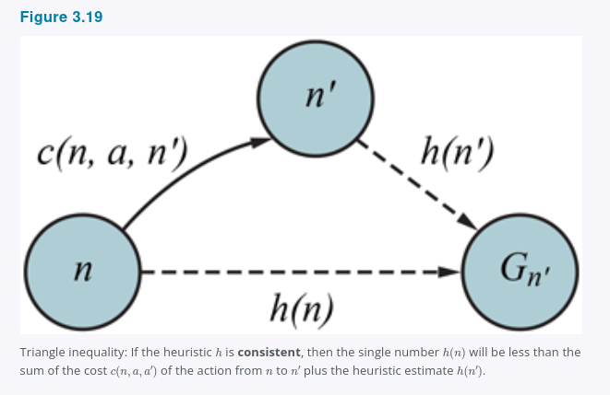
3.5.2
Consistency and the triangle inequality
h(n) ≤ c(n, a, n′) + h(n′)
For every node n and every successor n′ generated by an action a: the estimate at n can be no larger than the cost of the step plus the estimate at n′.
In other words, h can never drop by more than the cost of the move you just made.
This is a triangle inequality: no side of a triangle can be longer than the sum of the other two. hSLD satisfies it — straight-line distances are exactly a metric.
Figure 3.19
Consistency is a stronger condition than admissibility, and it is easier to check: admissibility is a claim about every node's relationship to a global optimum, while consistency is a purely local check on one edge at a time.
COMP 469 · AIMA 3.5–3.6
17
Notes:
[0:41-0:45] Consistency.
Give the intuitive reading before the formal one: 'if you take a step that costs 5, your estimate of the remaining distance may not fall by more than 5.' A heuristic that drops by 40 after a 5-cost step is telling you something impossible.
Point at Figure 3.19 while you say it. The triangle is n, n', and the goal G.
Emphasize the practical advantage of consistency: it is a LOCAL condition. You can verify it by checking every edge, without knowing any optimal costs. Admissibility, checked directly, requires knowing h*(n) - which usually means solving the problem. This is why most heuristics in practice are proved consistent, and admissibility comes along for free.

Slide 18
3.5.2 · WHY IT MATTERS IN CODE
Every consistent heuristic is admissible — not the reverse
ADMISSIBLE
WITH A CONSISTENT h
The first time you reach a state, you reach it optimally
Never re-add a state to the frontier, never update reached
CONSISTENT
A* is cost-optimal
in both regions
WITH AN INCONSISTENT h
but the frontier behaves
very differently
Multiple paths may reach the same state, each cheaper than the last
Multiple frontier nodes per state — costs time and space
Fixing it means one entry per state plus updating all successors, which requires child pointers as well as parent pointers
Felner et al. (2011): the worst effects rarely occur in practice. Do not be afraid of inconsistent heuristics.
COMP 469 · AIMA 3.5–3.6
18
Notes:
[0:45-0:49] Consistency versus admissibility in practice.
The containment picture is the exam answer: consistent implies admissible, the converse is false. Ask if anyone can sketch an admissible-but-inconsistent heuristic - a single node whose h is much too low relative to its neighbour does it.
The implementation consequences are the real content here. Many textbook A* implementations quietly assume consistency: they never re-open a node from the reached table. That is correct with a consistent heuristic and WRONG with a merely admissible one. If your students are implementing A* for a project, this is the bug they will hit.
Close on the Felner point so they do not over-correct into avoiding useful inconsistent heuristics.

Slide 19
3.5.2 · THE CONCRETE FAILURE
Where a merely admissible heuristic goes wrong
With a consistent h you reach every state optimally the first time. Here is the failure when h is admissible but not consistent.
THE TRACE
WHERE CONSISTENCY BITES
A* pops state C by an expensive path and records C in reached.
It expands C and eventually generates a goal through it.
Only later does a cheaper path to C come off the frontier.
reached says C is finished, so that path is discarded — and the optimal solution goes with it.
The offending edge: h(n) = 4, step cost 1, h(n′) = 1. Since 4 > 1 + 1, h is inconsistent.
Raise h(n′) to 2 and that edge is consistent. C is now popped by the cheap path first, and A* returns the optimum.
Both versions are admissible. Only one of them orders the pops correctly.
IF YOU READ OTHER SOURCES
AIMA 4e folds tree search and graph search into one best-first algorithm with a reached table. Berkeley CS188 and AIMA 3e keep them apart: A* tree search is cost-optimal with an admissible heuristic, while A* graph search needs a consistent one. Their fringe is our frontier, and their closed set is our reached table. Same algorithms, older vocabulary.
COMP 469 · AIMA 3.5–3.6
19
Notes:
[0:49-0:52] Why graph search needs consistency.
Draw the counterexample rather than describing it. Start S with two routes to C: a direct expensive edge, and a two-step cheaper route through some node B. Give C's predecessor on the cheap route a heuristic value that is much too low, so its f looks large and it sits on the frontier while the expensive route to C is popped first. C goes into reached, the cheap route arrives later and is thrown away.
Then fix it in front of them. The inconsistent edge is h(n) = 4 with a step of cost 1 to a node with h = 1: the estimate fell by 3 after a step that cost 1, which is impossible. Raise that value to 2 and the ordering repairs itself.
The sentence to land: admissibility constrains h against h*, which is a global object. Consistency constrains h against one edge at a time, and it is the ordering of pops — a local matter — that graph search actually depends on.
The vocabulary card is not a digression. Students will watch outside lectures and read the third edition, and the tree/graph split is the single biggest terminology difference they will hit. Reading it aloud costs thirty seconds and saves a lot of confused email.

Slide 20
3.5.2 · TWO SPECIAL CASES
When an inadmissible heuristic still gives you the optimal path
With an inadmissible heuristic A* may or may not be cost-optimal. Two cases where it still is:
1
One good path is enough
2
A small enough overestimate
If there is even one cost-optimal path along which h(n) is admissible for every node on that path, then that path will be found — no matter how badly the heuristic behaves for states off the path.
If the optimal solution costs C*, the second-best costs C2, and h never overestimates by more than C2 − C*, then A* is still guaranteed to return a cost-optimal solution.
Both are narrow guarantees. In the general case, deliberately giving up admissibility is a trade — you accept suboptimality to buy speed. That trade is the subject of 3.5.4.
COMP 469 · AIMA 3.5–3.6
20
Notes:
[0:49-0:52] Inadmissible heuristics that still work.
Keep this brief - it is a nuance slide, not a core slide. The reason to include it is that students often assume 'inadmissible' and 'wrong answer' are synonyms, and they are not.
Case 2 is the more useful one intuitively: the overestimate only hurts if it is large enough to make the optimal path look worse than the runner-up. If your heuristic is sloppy by 3 and the gap between best and second-best is 50, you are fine.
Use this as the bridge to weighted A*: if a little inadmissibility is survivable, maybe we should introduce it on purpose.

Slide 21
3.5 · LIVE DEMO
Watch three algorithms search the same maze
Everything so far has been argued. This is the part where you see it: same maze, same heuristic, three expansion patterns.
UNIFORM COST
GREEDY
A*
Radiates outward in every direction at once.
Expands nearly every state closer to the start than the goal is.
Optimal, and visibly wasteful.
Drives straight at the goal and expands very few nodes.
Returns a suboptimal path.
Never looks where the heuristic says 'farther', even when that way is cheaper.
More nodes than greedy, far fewer than uniform cost.
The path it returns is optimal.
You can watch both halves of f doing their work.
THE WATER MAZE — CHEAP SHALLOW SQUARES, EXPENSIVE DEEP ONES
Breadth-first counts steps, so it wades straight through the water. Uniform cost avoids the water but still searches in every direction. Only A* does both.
The same point in numbers, on the 8-puzzle at depth 12: uniform cost expands about 3.6 million nodes, A* with misplaced tiles expands 227, and A* with Manhattan distance expands 73.
COMP 469 · AIMA 3.5–3.6
21
Notes:
[1:00-1:04] Demo slot. Move it earlier or later freely — it is a breather, not a dependency.
Use the course Pac-Man demo here if it is ready; otherwise the Berkeley Project 1 mazes do the same job. Run all three algorithms on one maze without commentary first, then replay and narrate.
What to point at, in order: the shape of the expanded region for uniform cost (a disc), the shape for greedy (a finger pointed at the goal), and the shape for A* (a finger with a fat base). That is the contour picture from the next section, arriving early and for free.
The water maze is worth its own run because it is the only demo that separates breadth-first from uniform cost. Students who have quietly been treating 'number of steps' and 'cost' as the same thing find out here that they are not.
Close on the 8-puzzle numbers. The visual makes the difference feel like a factor of two or three; the numbers show it is four orders of magnitude. Both impressions are worth having.

Slide 22
WORK WITH A NEIGHBOUR · 5 MINUTES
Checkpoint 1
1
Is h(n) = 0 for all n admissible? Is it consistent? What algorithm does A* become?
2
A colleague multiplies hSLD by 1.3 to account for road curvature. Is the result still admissible? Is A* still guaranteed optimal?
3
Given two admissible heuristics h1 and h2, which of these are admissible? max(h1, h2) · (h1 + h2) / 2 · h1 + h2
4
Your A* implementation checks whether a node is a goal the moment it is generated. Give a concrete Romania example where this returns the wrong answer.
Question 4 is the one to discuss out loud — it is the difference between an A* that works and an A* that quietly returns 450 instead of 418.
COMP 469 · AIMA 3.5–3.6
22
Notes:
[0:52-0:57] Checkpoint 1. Give three minutes of pair work, then two minutes of discussion.
ANSWERS.
1. h = 0 is admissible (it never overestimates - it underestimates maximally) and consistent (0 ≤ c + 0 for any non-negative cost). A* becomes uniform-cost search / Dijkstra's algorithm.
2. Not admissible in general - 1.3 × hSLD can exceed the true road distance whenever the actual roads are straighter than the detour index assumes. Optimality is no longer guaranteed. This is exactly weighted A* with W = 1.3, which is the next section. Note the guarantee we DO keep: the solution costs at most 1.3 × C*.
3. max(h1, h2) is admissible - it is one of the two values, each of which is ≤ h*. The average is admissible for the same reason (it lies between them). The SUM is not admissible in general - h1 + h2 can easily exceed h*. This is the trap; make sure it lands, because it returns in 3.6 when we discuss combining pattern databases.
4. Step (e) of Figure 3.18: Bucharest is generated with f = 450 via Fagaras. An early goal test returns that path immediately, costing 450 instead of the optimal 418.
After this, take the break.

Slide 23
BREAK
Ten minutes
When we come back: search contours, weighted A*, memory-bounded search,
bidirectional search — then where heuristics actually come from.
COMP 469 · AIMA 3.5–3.6
23
Notes:
[0:57-1:07] Break. Leave the slide up. Good time to answer individual questions about the optimality proof.

Slide 24
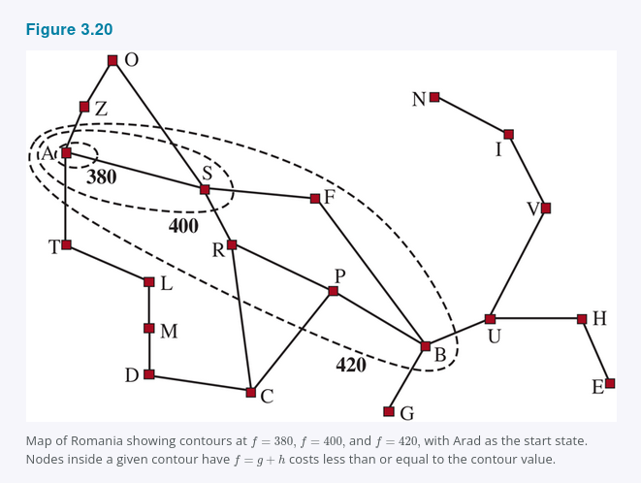
3.5.3
Search contours
Draw contours in the state space the way a topographic map draws elevation. Inside the contour labelled 400, every node has f(n) ≤ 400.
UNIFORM-COST SEARCH
Contours of g only. Circular around the start, spreading equally in all directions, with no preference toward the goal.
A* SEARCH
Contours of g + h. The bands stretch toward the goal. The better the heuristic, the more narrowly they hug the optimal path.
Figure 3.20
A perfect heuristic gives you a contour of width one: a straight walk down the optimal path.
COMP 469 · AIMA 3.5–3.6
24
Notes:
[1:07-1:11] Search contours.
This is the picture that makes heuristic quality intuitive. Sketch three versions on the board next to the figure: concentric circles (h = 0, uniform cost), stretched ovals (decent h, the figure), and a thin cigar down the optimal path (near-perfect h).
The physical intuition: h acts like a gravitational pull that deforms the circles toward the goal. Every bit of accuracy in h converts directly into contour narrowing, and contour narrowing converts directly into nodes you never touch.
This slide is also the visual you should call back to for beam search and weighted A* later - both are about deliberately searching only a slice of the contour.

Slide 25
3.5.3 · A CONSEQUENCE OF CONSISTENCY
Is f monotonically increasing along a path?
g ALWAYS INCREASES
f = g + h DOES NOT, IN GENERAL
Action costs are positive, so path cost grows monotonically. You get nested contour lines that never cross, and you can always draw a line between any two nodes on a path.
Extending a path from n to n′ takes f from g(n) + h(n) to g(n) + c(n, a, n′) + h(n′). Cancel g(n) and the question becomes whether h(n) ≤ c(n, a, n′) + h(n′).
f is monotonically increasing along every path ⟺ h is consistent
Plateaus are still possible: a path can contribute several nodes in a row with the same f, whenever the drop in h exactly equals the action cost. On a grid where n is in the same row as the goal, stepping toward the goal raises g by 1 and lowers h by 1, leaving f unchanged.
Consistency is not an extra technical hurdle — it is precisely the condition that makes the contour picture on the previous slide true.
COMP 469 · AIMA 3.5–3.6
25
Notes:
[1:11-1:14] Monotonicity.
This slide connects two things students usually store separately: the algebraic definition of consistency and the visual contour picture. They are the same fact. Contours only nest properly if f never decreases, and f never decreases exactly when h is consistent.
Do the cancellation on the board - it is two lines and it makes the equivalence obvious rather than magical.
The grid plateau example is worth drawing: same row as the goal, step right, g goes 4 to 5, h goes 3 to 2, f stays at 7. That is a flat stretch, not a decrease, which is why we say monotonically increasing in the weak sense.

Slide 26
3.5.3
Surely expanded nodes and optimal efficiency
Let C* be the cost of the optimal solution path. Then A* with a consistent heuristic divides the state space into three regions:
f(n) < C*
f(n) = C*
f(n) > C*
SURELY EXPANDED
THE GOAL CONTOUR
NEVER EXPANDED
Every node reachable from the initial state on a path where every node has f < C* is expanded. No exceptions.
A* may expand some of these before it selects a goal node. Tie-breaking decides how many.
A* expands no node whose f exceeds C*. These are pruned without ever being examined.
OPTIMALLY EFFICIENT
Any algorithm that extends paths from the initial state using the same heuristic information must expand every node that A* surely expands — because any one of them could be part of an optimal solution. A* with a consistent heuristic expands no more than that.
COMP 469 · AIMA 3.5–3.6
26
Notes:
[1:14-1:18] Optimal efficiency.
Define 'surely expanded' carefully - it is a subtle phrase. It is not 'all nodes with f < C*'; it is all nodes reachable on a PATH where EVERY node on that path has f < C*. A node with small f sitting behind a node with large f is not surely expanded.
The optimal-efficiency claim is a strong one and students should understand what it does and does not say. It says: given the same heuristic, nobody beats A* on the surely-expanded set. It does NOT say A* is fast, and it does not say A* expands the fewest nodes overall - among nodes on the goal contour, a lucky algorithm might do better. We simply do not count luck.
Ask: how could you make the goal-contour region smaller? Answer: better tie-breaking (prefer larger g among equal f) and a more accurate heuristic. Both are practical tricks worth knowing.

Slide 27
3.5.3
Pruning — and the catch
THE GOOD NEWS: PRUNING
THE BAD NEWS: EXPONENTIAL BLOW-UP
In Figure 3.18(b), Timisoara has f = 447 and Zerind has f = 449. Both are children of the root — breadth-first or uniform-cost search would expand them almost immediately. A* never expands either, because a solution with f = 418 is found first.
Eliminating possibilities without examining them is central to much of AI.
For many problems the number of nodes expanded is exponential in the length of the solution.
Consider a vacuum world with a super-powerful vacuum that cleans any square for 1 unit without visiting it. Squares can be cleaned in any order.
N dirty squares → 2^N states, all with f(n) < C* → A* expands every one of them
A* being complete, cost-optimal, and optimally efficient is satisfying — but it is not the answer to all our searching needs. The binding constraint is almost always memory, not time.
COMP 469 · AIMA 3.5–3.6
27
Notes:
[1:18-1:21] Pruning and its limits.
Two halves, deliberately balanced. Left: this is why A* is a big deal. Right: this is why the next three sections exist.
Make the vacuum example concrete. With N = 20 dirty squares, that is over a million states, all of them on some optimal solution path (the order of cleaning does not matter, so every subset is reachable optimally), all with f < C*. A* is obligated to expand all of them. No heuristic fixes this - the problem is that the optimal solution set is genuinely huge.
Land the transition: from here on, every algorithm in 3.5 is a response to the memory problem. Weighted A* trades optimality for a narrower contour; beam, IDA*, RBFS, and SMA* trade time for space.

Slide 28
3.5.4 · GOOD ENOUGH, AND FAST
Satisficing search
A* explores fewer nodes if we are willing to accept solutions that are suboptimal but good enough — what Herbert Simon called satisficing solutions. Allowing an inadmissible heuristic risks missing the optimum, but the heuristic can be more accurate, and accuracy shrinks the contour.
THE DETOUR INDEX
GENERALISE IT
Road engineers multiply straight-line distance by a constant to account for the typical curvature of roads.
Two cities 10 miles apart in a straight line are about 13 miles apart by road at an index of 1.3. Most localities fall between 1.2 and 1.6.
Apply the same idea to any problem, not just roads: weight the heuristic more heavily than the path cost.
This is weighted A* search.
f(n) = g(n) + W × h(n), for some W > 1
If the optimal solution costs C*, weighted A* returns a solution costing between C* and W × C* — usually much closer to C*.
COMP 469 · AIMA 3.5–3.6
28
Notes:
[1:21-1:24] Satisficing search and weighted A*.
'Satisficing' is Herbert Simon's coinage - satisfy plus suffice. Worth naming because it recurs throughout AI, not just in search.
The detour index is a genuinely good example because it shows the inadmissibility is not sloppiness - it is a deliberate correction toward accuracy. Straight-line distance is systematically too low. Multiplying by 1.3 makes it more accurate on average while making it inadmissible in the worst case. That is precisely the trade.
The bound at the bottom is the key theoretical result. Say it plainly: you give up optimality but you do not give up control. W is a dial with a guarantee attached.

Slide 29
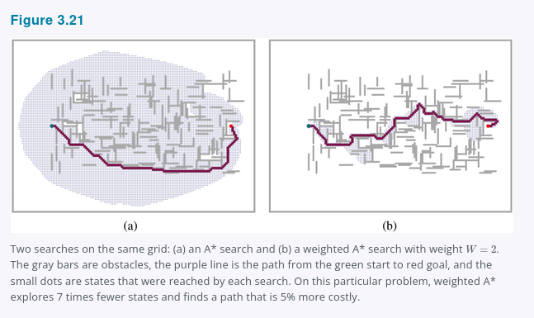
FIGURE 3.21
Weighted A* in a grid world
(a) A*, W = 1
Finds the optimal solution, but explores a large portion of the state space to prove it.
(b) WEIGHTED A*
Finds a slightly costlier solution far faster. The weighting pulls the contour of reached states toward the goal, so fewer states are explored.
The failure mode is visible in (b): if the optimal path ever strays outside the weighted search's narrowed contour — as it does here — the optimal path is not found.
COMP 469 · AIMA 3.5–3.6
29
Notes:
[1:24-1:27] Figure 3.21.
Point at the shaded regions. The left picture is A* proving optimality; the right picture is weighted A* declining to. The area difference is the compute you save.
Then point at where the optimal path leaves the shaded region on the right. That is the whole cost of the trade in one visual. Ask: what would happen as W increases further? The contour narrows further, the search gets faster, and the solution quality degrades toward the W × C* bound.
Practical note worth mentioning: in real planners, W is often started high for a fast first solution and then decreased on subsequent iterations - anytime weighted A*. Hatem and Ruml (2014) give a simplified version that is easier to implement.

Slide 30
3.5.4 · WEIGHTED A* GENERALISES EVERYTHING WE HAVE SEEN
One family, one knob
Algorithm
Evaluation function
W
Behaviour
Uniform-cost search
g(n)
W = 0
Ignores the goal entirely; circular contours
A* search
g(n) + h(n)
W = 1
Optimal, optimally efficient, memory-hungry
Weighted A* search
g(n) + W × h(n)
1 < W < ∞
Bounded suboptimal; narrower contour
Greedy best-first search
h(n)
W = ∞
Ignores path cost entirely
CALL IT SOMEWHAT-GREEDY SEARCH
Like greedy best-first search, weighted A* focuses the search toward the goal. Unlike greedy search, it does not ignore path cost — it will suspend a path that is making little progress at great expense.
Exam-ready framing: name any algorithm in 3.4 or 3.5 by stating its f. That is the entire taxonomy.
COMP 469 · AIMA 3.5–3.6
30
Notes:
[1:27-1:29] The unifying table.
This slide pays off the framing from the recap slide. Everything is one algorithm with a dial.
Do not rush past the W = 0 and W = ∞ endpoints - they are the sanity check that the parameterisation is right. At W = 0 the h term vanishes and you have Dijkstra. As W grows without bound the g term becomes negligible in comparison and you have greedy.
If time allows, ask what W < 1 would mean. Answer: a search that trusts h less than A* does - it is still optimal (since W·h ≤ h ≤ h* when W < 1 and h admissible) but expands more nodes than A*. Strictly worse, which is why nobody uses it.

Slide 31
3.5.4 · WHAT COUNTS AS GOOD ENOUGH?
Flavours of suboptimal search
BOUNDED SUBOPTIMAL
Weighted A* provides exactly this guarantee.
Find a solution guaranteed to be within a constant factor W of the optimal cost.
BOUNDED COST
Useful when there is a hard budget rather than a quality target.
Find a solution whose cost is less than some fixed constant C.
UNBOUNDED COST
Speedy search is the canonical example.
Accept a solution of any cost, as long as it can be found quickly.
SPEEDY SEARCH
Greedy best-first search on the estimated number of ACTIONS to a goal, ignoring what those actions cost. Identical to greedy search under unit costs; with varied costs it finds a solution fast, possibly an expensive one.
COMP 469 · AIMA 3.5–3.6
31
Notes:
[1:29-1:31] Categories of suboptimal search. Move briskly - this is vocabulary, not machinery.
The distinction that matters for the exam is bounded suboptimal (a factor of optimal) versus bounded cost (an absolute number). Students mix them up. Factor versus absolute.
Speedy search is a nice illustration that 'fast' and 'cheap' are different objectives. Wilt and Ruml (2016) showed the best heuristics for satisficing search are not the same as the best heuristics for optimal search - a result worth mentioning to anyone doing a project on search.

Slide 32
3.5.5
Memory-bounded search: where the memory goes
The main issue with A* is memory, not time. Memory is split between two structures, and a state on the frontier lives in both of them.
FRONTIER
REACHED
Priority queue of nodes, so we can decide what to expand next. Usually much smaller than reached.
Table of every state we have seen, so we can detect redundant paths. This is what actually exhausts memory.
Three implementation tricks that reclaim space:
1
Store each state once
Keep a state in only one of the two structures. Saves space at the cost of complicating and slowing the algorithm.
2
Drop reached entirely
With the separation property (Figure 3.6) and no U-turns, every action leads outward from or along the frontier — so checking the frontier alone suffices.
3
Reference counting
Delete a state once no further path can reach it. On a 4-neighbour grid, remove it after its fourth arrival.
COMP 469 · AIMA 3.5–3.6
32
Notes:
[1:31-1:34] Where memory goes.
Make sure the frontier/reached distinction is solid before you introduce the four algorithms that follow - all of them are attacks on one or both of these structures.
The reference-counting trick is the most concrete: on a 2D grid every cell has exactly four neighbours, so once four different neighbours have generated it, no fifth path can ever arrive, and it can be dropped from reached. That is a real technique used in grid pathfinding.
Set up the next four slides: two of them (beam, weighted A*) give up solution quality; two of them (IDA*, RBFS) give up time by re-expanding; SMA* tries to use exactly the memory you actually have.

Slide 33
3.5.5
Beam search
Limit the size of the frontier. Keep only the k nodes with the best f-scores and discard everything else that gets expanded.
IN CONTOUR TERMS
Uniform-cost and A* spread out everywhere in concentric contours.
Beam search explores only a focused portion of those contours — the slice containing the k best candidates.
If the optimal path leaves that slice, beam search will never find it. That is the price of the bound.
COMPLETE
No
OPTIMAL
No
FRONTIER SIZE
k
Choose k to fit the memory you actually have
Runs fast because it expands far fewer nodes
On many problems it finds good near-optimal solutions
Variant: instead of a hard limit, keep every node whose f is within δ of the best f — few nodes kept when one candidate is strong, more kept when none is
Beam search reappears in Chapter 4 as a local search method, and again in NLP decoding.
COMP 469 · AIMA 3.5–3.6
33
Notes:
[1:34-1:36] Beam search.
Short slide. The key framing is the contour one on the right - beam search is a vertical slice through the contour rather than the whole band.
The δ-variant is worth thirty seconds because it is adaptive: it keeps the frontier small when the heuristic is confident and lets it grow when the heuristic cannot discriminate. That is generally better behaviour than a fixed k.
Mention that students will meet beam search again - it is how sequence models generate text. Same algorithm, different state space. That connection tends to make it memorable.

Slide 34
3.5.5
Iterative-deepening A* (IDA*)
IDA* is to A* what iterative-deepening search is to depth-first search
STANDARD ITERATIVE DEEPENING
IDA*
The cutoff is the depth, increased by one each iteration.
The cutoff is the f-cost g + h. Each iteration exhaustively searches one f-contour, finds a node just beyond it, and uses that node's f-cost as the next contour.
WHERE IT SHINES
WHERE IT BREAKS DOWN
Integer f-costs, as in the 8-puzzle: steady progress toward the goal, and no more than C* iterations — at most 31 on the hardest 8-puzzles.
Real-valued or all-distinct f-costs: each new contour may contain exactly one new node, so the number of iterations approaches the number of states.
COMP 469 · AIMA 3.5–3.6
34
Notes:
[1:36-1:39] IDA*.
The one-line analogy at the top does most of the work. Then the only new idea is that the cutoff is an f-value rather than a depth, and that the next cutoff is chosen as the minimum f that exceeded the current one - not incremented by a fixed step. Students who try to increment by 1 get a broken algorithm on non-unit costs.
Memory: O(d), because it is depth-first inside each iteration. That is the entire point.
The failure mode on the right is important and often skipped. With real-valued costs (say, actual road distances in kilometres to two decimals), almost every node has a unique f, so you re-run a nearly-complete search for each node. Patrick et al. (1992) analyse this. In practice people bucket the f-values to avoid it.

Slide 35
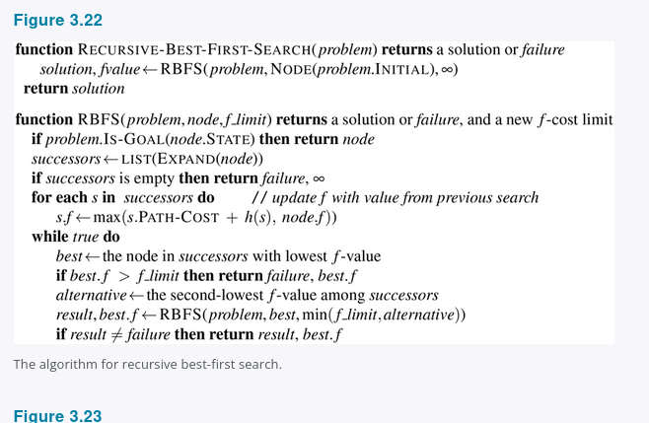
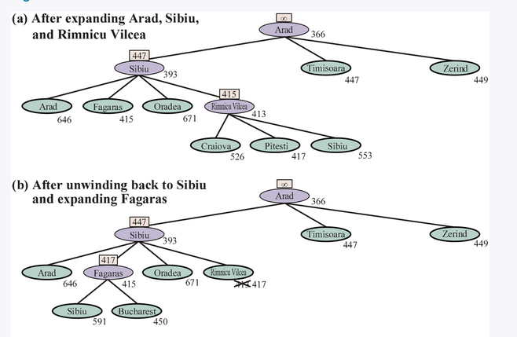
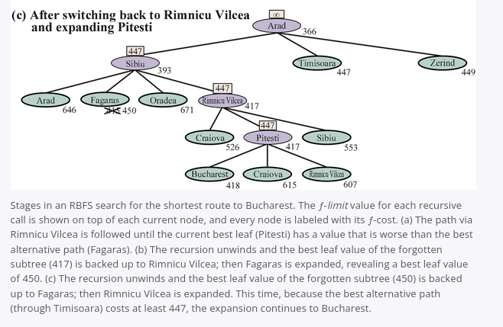
3.5.5 · FIGURE 3.23
Recursive best-first search (RBFS)
RBFS mimics best-first search using only linear space. It resembles a recursive depth-first search, but instead of descending indefinitely it tracks f_limit — the f-value of the best alternative path available from any ancestor. When the current node exceeds that limit, the recursion unwinds.
As the recursion unwinds, RBFS replaces each node's f-value with a backed-up value — the best f-value among its children — so it remembers how good the forgotten subtree was.
IT CHANGES ITS MIND
PROPERTIES
Rimnicu Vilcea, then Fagaras, then back again. Extending the best path usually raises its f, so the runner-up becomes the leader and the search backtracks.
Optimal if h is admissible. Space linear in the depth of the deepest optimal solution. Time is hard to characterise — it depends on heuristic accuracy and how often the best path changes.
COMP 469 · AIMA 3.5–3.6
35
Notes:
[1:39-1:43] RBFS.
Walk the three panels. Panel (a): the search goes down through Rimnicu Vilcea, with 415 (Fagaras) held as the best alternative. Panel (b): once Pitesti's subtree exceeds 415, the recursion unwinds and Rimnicu Vilcea gets the backed-up value 417; Fagaras is tried instead. Panel (c): Fagaras exceeds 417, unwinds with backed-up value 450, and the search returns to Rimnicu Vilcea.
That back-and-forth is the 'mind change'. Each one corresponds to an iteration of IDA* and can require many re-expansions to rebuild the path.
Why do the mind changes happen? Because h is usually less optimistic near a goal, so f tends to rise as a path is extended. This is a consequence of the heuristic getting more accurate, not less - a nice counterintuitive point.
RBFS is more efficient than IDA* but still suffers excessive node regeneration.

Slide 36
3.5.5
SMA*: use all the memory you actually have
IDA* and RBFS suffer from using too little memory. Between iterations IDA* retains one number — the current f-cost limit. RBFS keeps more, but only linear space; even if more memory were available it has no way to use it. Both re-explore the same states many times over.
Simplified memory-bounded A* (SMA*) determines how much memory is available and uses all of it:
EXPAND
DROP
BACK UP
REGENERATE
Proceed exactly like A*, expanding the best leaf, until memory is full.
Now a new node cannot be added without removing an old one. SMA* always drops the worst leaf — highest f-value.
Like RBFS, back up the forgotten node's value to its parent, so the ancestor of a forgotten subtree still knows how good that subtree was.
Rebuild a forgotten subtree only once every other path has been shown to look worse than the one it forgot.
TIE-BREAKING SUBTLETY
THRASHING
If all leaves share the same f, SMA* would pick the same node to expand and delete. So it expands the newest best leaf and deletes the oldest worst leaf.
On hard problems SMA* switches endlessly among candidate paths that do not fit in memory — like paging thrash. Memory limits can make a problem intractable in TIME.
COMP 469 · AIMA 3.5–3.6
36
Notes:
[1:43-1:46] SMA*.
Four-step process across the middle. The key idea is 'drop the worst leaf but remember how good it was' - the same backed-up-value trick as RBFS, now applied to a memory-full condition rather than a recursion unwind.
Properties: complete if the shallowest goal depth d is less than the memory size in nodes; optimal if any optimal solution is reachable within memory, otherwise it returns the best reachable solution.
The tie-breaking subtlety is worth the thirty seconds because of the edge case: if there is only one leaf, the search tree is a single root-to-leaf path filling all of memory. If that leaf is not a goal, then even if it sits on an optimal solution path, that solution is unreachable with the memory you have - so it can be discarded as if it had no successors.
End on the thrashing point. It is the most important sentence in 3.5.5: memory limitations can convert a time-feasible problem into an infeasible one. The only escape is to give up optimality.

Slide 37
3.5.5 · SUMMARY
The memory-bounded family at a glance
Algorithm
Space
Complete
Optimal
What you pay
A*
O(nodes expanded)
Yes
Yes (admissible h)
Memory — the binding constraint
Weighted A*
O(nodes expanded)
Yes
Bounded by W × C*
Solution quality
Beam search
O(k)
No
No
Completeness and quality
IDA*
O(d)
Yes
Yes (admissible h)
Re-expansion; bad on real-valued f
RBFS
O(d)
Yes
Yes (admissible h)
Re-expansion from mind changes
SMA*
All available
If d < memory
If reachable
Thrashing on hard instances
SMA* is a robust default for optimal solutions when the state space is a graph, action costs are not uniform, and node generation is expensive relative to frontier bookkeeping.
COMP 469 · AIMA 3.5–3.6
37
Notes:
[1:46-1:48] Summary table. This is a slide students will photograph - pause on it.
Read down the Space column: that is the story of the whole subsection. O(nodes) is unaffordable, O(k) and O(d) are affordable but cost you something, and SMA* is the compromise that spends exactly what you have.
If asked 'which should I use?' the honest answer is: A* if it fits in memory, IDA* if the costs are integers and it does not, weighted A* if you can tolerate suboptimality, SMA* if you need optimality and have a fixed memory budget.

Slide 38
3.5.6
Bidirectional heuristic search
We could try running bidirectional best-first search with f(n) = g(n) + h(n), but there is no guarantee this gives an optimal-cost solution, nor that it is optimally efficient — even with an admissible heuristic.
NOTATION
WHY TWO FUNCTIONS?
fF(n) = gF(n) + hF(n) going forward from the initial state.
fB(n) = gB(n) + hB(n) going backward from a goal.
Both directions solve the same problem, but the heuristics differ depending on whether you are striving for the goal or for the initial state.
lb(m, n) = max( gF(m) + gB(n), fF(m), fB(n) )
A lower bound on any solution running from the start to m, somehow to n, then to the goal — the connection cannot cost less than zero, and each half's f is already optimistic.
Theorem: for any pair m, n with lb(m, n) < C*, we must expand either m or n, because the path through both is a potential optimal solution.
It is pairs of nodes, not individual nodes, that are surely expanded — so no bidirectional search can be optimally efficient.
COMP 469 · AIMA 3.5–3.6
38
Notes:
[1:48-1:51] Bidirectional heuristic search theory.
This is the most abstract slide in Part 1. Signpost that clearly and tell students the payoff arrives on the next slide with a concrete evaluation function.
The essential shift: in unidirectional A* we reason about which individual nodes must be expanded. In bidirectional search that reasoning fails, because a solution is defined by a MEETING - a pair of nodes, one from each frontier. Eckerle et al. (2017) formalised this and proved the consequence: no bidirectional algorithm is optimally efficient, because it cannot know which member of a surely-expanded pair to expand.
Some algorithms explicitly manage a queue of (m, n) pairs - NBS, Chen et al. 2017. We will stick with the simpler approach on the next slide.

Slide 39
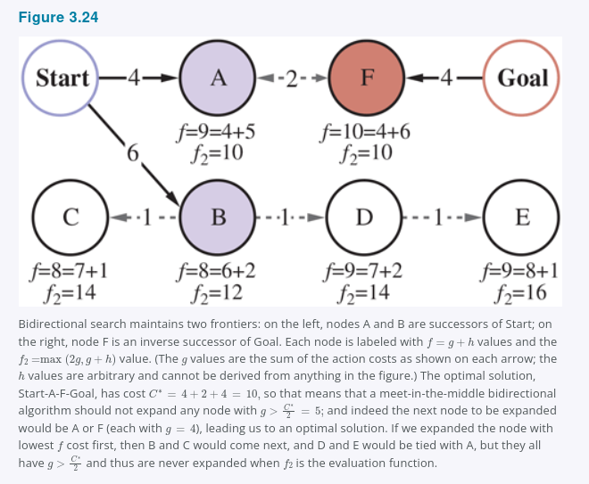
3.5.6 · FIGURE 3.24
Meet in the middle
f₂(n) = max( 2g(n), g(n) + h(n) )
Use bidirectional best-first search with two frontier priority queues and give it an evaluation function that mimics the lb criterion. Expand whichever node minimises f₂ — it may come from either frontier.
THE GUARANTEE
f₂ ensures we never expand a node from either frontier with g(n) > C*/2. When the two frontiers touch, no node inside either one has a path cost above C*/2 — the halves meet in the middle.
COMPLETE
Yes
OPTIMAL
Yes (admissible h)
Figure 3.24 — a worked bidirectional search
COMP 469 · AIMA 3.5–3.6
39
Notes:
[1:51-1:54] Meet in the middle.
Explain why f2 has that shape. The 2g(n) term is the enforcement mechanism: if g(n) exceeds C*/2, then 2g(n) exceeds C*, so f2 exceeds C*, so the node is never selected. That single term is what forces the two searches to meet near the midpoint rather than one running away with the whole problem.
The g(n) + h(n) term is ordinary A* guidance, keeping the search pointed in the right direction within that constraint.
Holte et al. (2016) is the reference for the meet-in-the-middle version. Emphasise the practical benefit: two searches of depth d/2 instead of one of depth d, which under a branching factor b means 2b^(d/2) rather than b^d.

Slide 40
3.5.6
Front-to-end, front-to-front, and when to bother
FRONT-TO-END SEARCH
FRONT-TO-FRONT SEARCH
What we described: hF estimates the distance to the goal (or to the closest goal, if there are several), and hB estimates the distance to the start.
Estimate the distance to the other frontier instead. Applying h to millions of frontier nodes is hopeless, but you can sample a few — or summarise the frontier, e.g. maintain a bounding box in a grid problem and measure distance to the box.
Is bidirectional search worth it? It depends entirely on heuristic quality:
Very good heuristic
A* already produces contours tightly focused on the goal. Bidirectional search adds little.
Average heuristic
Meeting in the middle tends to expand fewer nodes. Bidirectional search is preferred.
Poor heuristic
The search is no longer focused on the goal, and bidirectional search has the same asymptotic complexity as A*.
COMP 469 · AIMA 3.5–3.6
40
Notes:
[1:54-1:56] Front-to-end versus front-to-front, and the practical verdict.
The three-row table is the takeaway. The counterintuitive row is the first one: a BETTER heuristic makes bidirectional search LESS valuable, because A* is already doing the job. Bidirectional search is a way of compensating for a mediocre heuristic.
Real-world note that ties to Part 2: Microsoft's mapping service combined bidirectional A* with precomputed landmarks (Goldberg et al. 2006) and found optimal routes in a 24-million-node graph of the United States while searching less than 0.1% of it. That is the bridge into 3.6 - hold it for the section divider.
That completes 3.5. Quick breath, then Part 2.

Slide 41
PART 2
3.6 Heuristic
Functions
How accuracy affects performance — and where good heuristics actually come from.
COMP 469 · AIMA 3.5–3.6
41
Notes:
[1:56] Transition.
One sentence of framing before you advance: everything in Part 1 assumed somebody handed us h. Part 2 is where h comes from. Four sources, in order: relaxed problems, pattern databases, landmarks, and learning.

Slide 42
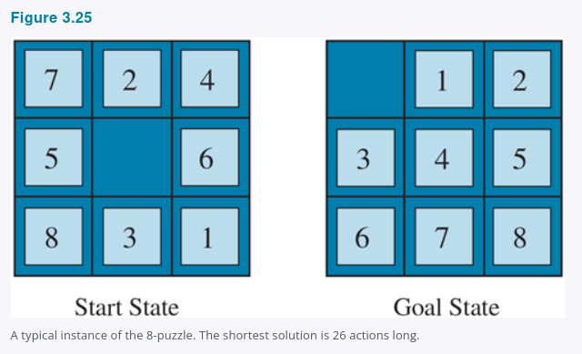
3.6 · FIGURE 3.25
Back to the 8-puzzle
WHY THIS PROBLEM
8-puzzle: 9!/2 = 181,440 reachable states — small enough to hold in memory.
15-puzzle: 16!/2 states, over 10 trillion — we need a good admissible heuristic.
h₁ · MISPLACED TILES
Count the tiles out of position, blank excluded. All eight are misplaced here, so h₁ = 8.
h₂ = 3+1+2+2+2+3+3+2 = 18
h₂ · MANHATTAN DISTANCE
Sum, over all tiles, of the horizontal plus vertical distance from the goal position. Tiles cannot move diagonally, hence city-block distance.
Admissible: one move brings one tile one step closer.
The true shortest solution is 26 moves.
Neither h₁ = 8 nor h₂ = 18 overestimates it.
COMP 469 · AIMA 3.5–3.6
42
Notes:
[1:56-2:00] The 8-puzzle and its two classic heuristics.
Have the class compute h1 together in fifteen seconds - just count tiles that are not where the goal puts them. All eight.
Then walk one term of h2 on the board so the sum is not mysterious. Tile 7 in the start state sits top-left; in the goal it sits bottom-middle. That is 2 rows down and 1 column across, so 3. Do one more and let them trust the rest.
The state-space sizes justify the whole section. 181,440 states is nothing (the textbook prints 181,400; 9!/2 is 181,440) - you could breadth-first search it. Ten trillion is not searchable by any method in 3.4. The gap between those numbers is exactly what a good heuristic buys.
Set up the next slide by asking: we can see that h2 is bigger, but how would we MEASURE which heuristic is better?

Slide 43
3.6.1 · EFFECTIVE BRANCHING FACTOR
Measuring heuristic quality
Suppose A* generates N nodes to solve a problem whose solution lies at depth d. The effective branching factor b* is the branching factor a uniform tree of depth d would need in order to contain N + 1 nodes:
N + 1 = 1 + b* + (b*)² + … + (b*)ᵈ
A WORKED VALUE
WHY IT IS A USEFUL MEASURE
If A* finds a solution at depth 5 using 52 nodes, then b* = 1.92.
A well-designed heuristic has b* close to 1 — meaning large problems stay tractable.
b* varies across instances, but for a given domain such as the 8-puzzle it is fairly constant across all nontrivial instances. So measuring it on a small sample predicts overall usefulness.
AN ALTERNATIVE: EFFECTIVE DEPTH (KORF & REID, 1998)
Rather than shrinking the branching factor, think of the heuristic as reducing the effective depth by a constant kh. Total search cost becomes O(b^(d − kh)) instead of O(b^d). Their experiments on Rubik's Cube and n-puzzles predict total search cost accurately across a wide range of solution lengths.
COMP 469 · AIMA 3.5–3.6
43
Notes:
[2:00-2:03] Effective branching factor.
The definition is easier said than written: pretend the search tree was a perfect uniform tree; what branching factor would explain the number of nodes you actually generated? Lower is better; 1.0 would mean the search walked straight down the solution path with no branching at all.
You can sanity-check the worked value on the board: 1 + 1.92 + 1.92^2 + 1.92^3 + 1.92^4 + 1.92^5 is about 53, so N + 1 = 53 and N = 52. Good.
The Korf and Reid reframing is worth stating because it changes the intuition. A heuristic does not make each node have fewer children - it makes the effective problem shallower. Subtracting a constant from the exponent is an exponential speedup, which is why a small improvement in h pays so well.

Slide 44
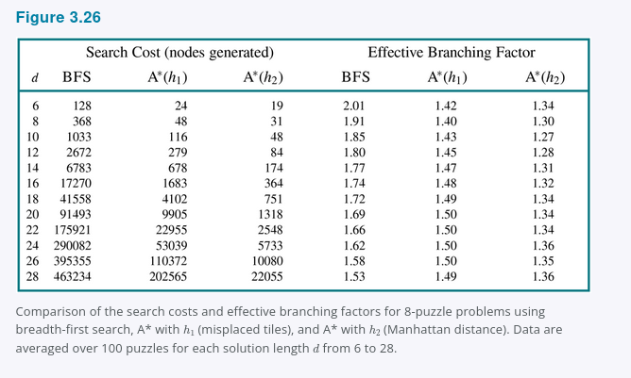
FIGURE 3.26
What the numbers actually look like
THE SETUP
Random 8-puzzle instances solved three ways: uninformed breadth-first search, A* with h₁, and A* with h₂. Averaged over 100 puzzles at each solution length d from 6 to 28.
AT DEPTH 24
BFS generates 290,082 nodes.
A* with h₁ generates 53,039.
A* with h₂ generates 5,733.
b* falls from 1.62 to 1.50 to 1.36.
h₂ beats h₁, and both beat no heuristic at all — and the gap widens as the problems get harder. That is the shape of an exponential saving.
COMP 469 · AIMA 3.5–3.6
44
Notes:
[2:03-2:06] Figure 3.26.
Do not read the table aloud. Pick the depth-24 row and read across it, then let the students find the trend themselves.
Two things to draw out. First, the ratios: at depth 24, h2 is roughly 50x better than BFS and 9x better than h1. Second, look at how the b* columns barely move while the node counts explode - that is the whole point of using b* as the measure, because a small difference in the base becomes an enormous difference once it is raised to the power d.
Ask them to look at the last row (d = 28) and extrapolate to the 15-puzzle at d = 50 or 60. That extrapolation is why pattern databases exist.

Slide 45
3.6.1 · IS H₂ ALWAYS BETTER THAN H₁?
Domination
Essentially, yes — and we can prove it from the definitions.
h₂(n) ≥ h₁(n) for every node n ⟹ h₂ dominates h₁
WHY DOMINATION MEANS EFFICIENCY
THE ONE CAVEAT
Recall from 3.5 that every node with f(n) < C* is surely expanded — equivalently, with a consistent h, every node with h(n) < C* − g(n) is surely expanded.
Since h₂ is at least as large as h₁ everywhere, every node surely expanded under h₂ is also surely expanded under h₁ — and h₁ may expand others besides.
A* with h₂ never expands more nodes than A* with h₁, except when tie-breaking goes badly.
So prefer a heuristic with higher values — provided it stays consistent, and provided computing it does not take too long. A heuristic that halves the node count and triples the per-node cost is a loss.
Design rule for the rest of this section: push h upward toward h* as far as you can, without making h expensive and without breaking admissibility.
COMP 469 · AIMA 3.5–3.6
45
Notes:
[2:06-2:09] Domination.
This is the theoretical backbone of everything that follows in 3.6. Every technique in the rest of the section - relaxed problems, pattern databases, landmarks, learning - is an attempt to produce a heuristic that dominates the obvious one.
The proof is three sentences and worth doing carefully on the board. Bigger h means a smaller surely-expanded set, because the condition for being surely expanded is that h is SMALL relative to the remaining budget.
The caveat deserves real emphasis because students overfit to 'bigger is better'. Computation time per node is real. Manhattan distance costs eight table lookups; a pattern database costs one lookup but a lot of memory; a learned neural heuristic might cost a millisecond, which can easily be worse than expanding a thousand extra nodes.

Slide 46
3.6.1 · THE SHAPE OF THE DESIGN SPACE
Domination is a partial order, not a ranking
h₂ dominates h₁, so h₂ wins. But most pairs of heuristics are not comparable at all — each is larger on some states and smaller on others.
THE ORDER
WHEN NEITHER DOMINATES
h = 0 sits at the bottom. Admissible, consistent, and no help whatsoever.
h = h* sits at the top. Perfect, and as expensive as solving the problem.
Every useful heuristic lives strictly between the two.
Climbing means expanding fewer nodes and usually paying more per node.
Two heuristics can be incomparable: each is larger on some states, smaller on others. Neither one is better.
That is what max(h₁, h₂) is for — the smallest heuristic dominating both, admissible whenever they are.
The order is closed under max and not under sum. You climb by combining, never by adding.
This is the map for the rest of 3.6: relaxed problems, pattern databases, landmarks and learned heuristics are four ways of climbing the same lattice.
COMP 469 · AIMA 3.5–3.6
46
Notes:
[2:09-2:12] The heuristic lattice.
Sketch it on the board while you talk: h = 0 at the bottom, h* at the top, arrows upward for dominates. Two incomparable heuristics sit side by side with no arrow between them, and their max sits above both. That picture is the whole slide.
The point students miss on the previous slide is that domination is rare. h2 dominating h1 on the 8-puzzle is a clean special case; in general you build two reasonable heuristics and neither wins everywhere. Asking 'which is better' is then the wrong question.
Which makes max the natural operator rather than a trick: it is the least upper bound in this order. It is also, usefully, the answer to 'I have five heuristics and cannot choose' — you do not have to choose.
Callback: sum is not in the order, per Checkpoint 1 question 3. Sitting with that asymmetry now sets up 3.6.3, where disjoint pattern databases engineer the one situation in which the sum is safe.

Slide 47
WORK WITH A NEIGHBOUR · 4 MINUTES
Checkpoint 2
1
Verify h₂ = 18 for the start state in Figure 3.25 by computing the Manhattan distance of tiles 1, 2 and 3 individually.
2
Define h₃(n) = h₁(n) + h₂(n). Is h₃ admissible? Does it dominate h₂? Would you use it?
3
A heuristic h₄ dominates h₂ but takes 500× longer per node to evaluate. Under what conditions is h₄ still the better choice?
4
Which is the stronger claim about a heuristic — that it is admissible, or that it is consistent? Give a one-line justification.
Question 2 is the trap from Checkpoint 1 in a new costume. Adding two admissible heuristics does not give an admissible heuristic — but there is a way to fix that, and it is the subject of the pattern-database slides coming up.
COMP 469 · AIMA 3.5–3.6
47
Notes:
[2:09-2:13] Checkpoint 2. Two to three minutes of pair work, then discuss.
ANSWERS.
1. Tile 1 is bottom-right in the start, and in the goal it is top-middle: 2 up, 1 across = 3... walk through with the figure on screen. What matters is that they perform the row-plus-column count correctly, not that they reproduce the textbook's ordering of the sum.
2. Not admissible. h1 counts each misplaced tile once; h2 already counts at least one move for each of those same tiles. The sum double-counts and can exceed h*. It does dominate h2 numerically, but domination only implies efficiency for ADMISSIBLE heuristics - an inadmissible one can expand fewer nodes and return the wrong answer. Do not use it if you need optimality; it is a legitimate weighted/satisficing heuristic if you do not.
3. When node expansion is itself expensive relative to heuristic evaluation - for example when generating a successor requires a physics simulation or a database write - or when memory, not time, is the binding constraint and h4 lets you finish at all. Also when h4 reduces node count by more than 500x, which pattern databases genuinely do.
4. Consistency is the stronger claim: every consistent heuristic is admissible, but not conversely.

Slide 48
3.6.2
Generating heuristics from relaxed problems
How might one have invented h₂ in the first place? Notice that h₁ and h₂ are not merely estimates for the 8-puzzle — they are exact path lengths for simplified versions of it.
IF A TILE COULD MOVE ANYWHERE
IF A TILE COULD MOVE ONE SQUARE ANY DIRECTION
…instead of only to the adjacent empty square, then h₁ (misplaced tiles) would give the exact length of the shortest solution.
…even onto an occupied square, then h₂ (Manhattan distance) would give the exact length of the shortest solution.
The cost of an optimal solution to a relaxed problem is an admissible heuristic for the original problem
A relaxed problem has fewer restrictions on its actions. Removing restrictions adds edges, so its state-space graph is a supergraph of the original.
Any optimal solution to the original problem is by definition still a solution in the relaxed problem — but the relaxed problem may have better solutions, using the added shortcuts. Hence the relaxed cost is a lower bound.
The derived heuristic is an exact cost in the relaxed space, so it obeys the triangle inequality — which makes it consistent, not merely admissible.
COMP 469 · AIMA 3.5–3.6
48
Notes:
[2:13-2:17] Relaxed problems. This is the conceptual high point of 3.6 - give it room.
The reframing is the thing: h1 and h2 are not approximations at all. They are exact answers to slightly different questions. That is why they are admissible, and it is a recipe rather than an accident.
Make the supergraph argument concrete. Draw two nodes and one edge, then add a shortcut edge. Any route that existed before still exists; some routes are now cheaper. So the optimal cost can only go down or stay the same. A quantity that is always ≤ the true optimum is exactly an admissible heuristic.
The consistency corollary is a nice bonus and students usually miss it: because h is a genuine shortest-path cost in some metric space, it automatically satisfies the triangle inequality. So relaxation gives you consistency for free.

Slide 49
3.6.2 · FROM A FORMAL PROBLEM DESCRIPTION
Relaxation can be done mechanically
Write the 8-puzzle's action rule in a formal language:
A tile can move from square X to square Y if X is adjacent to Y and Y is blank
Now generate relaxed problems by deleting one or both conditions:
(a)
A tile can move from X to Y if X is adjacent to Y
→ h₂, Manhattan distance
The proper score if we moved each tile in turn to its destination.
Drop the blank requirement
(b)
A tile can move from X to Y if Y is blank
→ Exercise 3.GASC
Left for you to work out.
Drop the adjacency requirement
(c)
A tile can move from X to Y if no conditions at all
→ h₁, misplaced tiles
The proper score if tiles could reach their destination in one action.
Drop both
Crucially, these relaxed problems can be solved without search — the relaxed rules decompose the puzzle into eight independent subproblems. If a relaxed problem is hard to solve, its heuristic is expensive to compute.
COMP 469 · AIMA 3.5–3.6
49
Notes:
[2:17-2:20] Mechanical relaxation.
This slide is the answer to the question 'could a computer invent h2?' Yes - if the problem is written in a formal language, deleting preconditions is a purely syntactic operation.
Walk (a) and (c) explicitly. In (a) a tile can slide to any adjacent square regardless of occupancy, so each tile walks independently to its home along a shortest grid path - that is exactly Manhattan distance. In (c) a tile can teleport, so each misplaced tile costs exactly one move - that is misplaced-tile count.
(b) is a genuine exercise in the book (3.GASC). Worth assigning.
The bottom note is the practical constraint that makes the whole technique work. Deleting preconditions is easy; the art is deleting the ones that make the remaining problem decomposable. That is what Absolver automated.

Slide 50
3.6.2
Automating it — and combining what you get
ABSOLVER (PRIEDITIS, 1993)
TOO MANY HEURISTICS?
A program that generates heuristics automatically from problem definitions, using the relaxed-problem method among others.
It produced a new 8-puzzle heuristic better than any that existed, and found the first useful heuristic for Rubik's Cube.
Suppose you have admissible h₁ … hₘ and none is clearly best. Which do you choose?
You do not have to choose.
h(n) = max { h₁(n), … , hₖ(n) }
WHAT YOU KEEP
WHAT IT COSTS
Picks whichever component is most accurate at each node. Admissible if the components are; consistent if they are; and it dominates every one of them.
Every component must be evaluated at every node. Alternatives: pick one at random, or use machine learning to predict the best one — faster in practice, but consistency can be lost.
COMP 469 · AIMA 3.5–3.6
50
Notes:
[2:20-2:23] Absolver and the max combination.
The max rule is one of the most useful practical facts in the chapter and it is easy to prove on the spot: if every hi is ≤ h*, then the largest of them is still ≤ h*. Admissibility survives the max. It does NOT survive the sum - callback to Checkpoint 1 question 3 and Checkpoint 2 question 2.
Note the asymmetry students should internalise: max is safe, sum is not, and the rest of 3.6.3 is about engineering a situation where the sum becomes safe.
The random-selection variant is a nice detail: it can produce an inconsistent heuristic even when every component is consistent, because two neighbouring nodes may be evaluated by different components. And yet it usually leads to faster problem solving. Theory and practice diverging is worth pointing out.

Slide 51
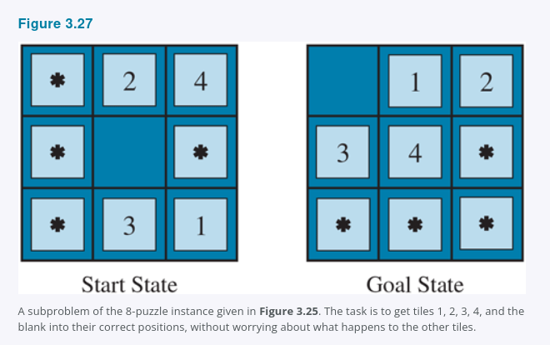
3.6.3 · HEURISTICS FROM SUBPROBLEMS · FIGURE 3.27
Pattern databases
Take a subproblem of the original: get tiles 1, 2, 3, 4 and the blank into their correct positions, and do not care what happens to the rest. Its optimal solution cost is a lower bound on the cost of the full problem.
STORE EVERY INSTANCE
9 × 8 × 7 × 6 × 5 = 15,120 patterns — every configuration of the four tiles plus the blank. Moving the other tiles still counts toward the cost.
BUILD IT ONCE
Search backward from the goal, recording each new pattern's cost. Amortised over every later query.
At search time, h_DB is one table lookup: find the current configuration of tiles 1–4 and the blank, read off the stored cost.
1-2-3-4 is arbitrary — build databases for 5-6-7-8, for 2-4-6-8, and so on. Each yields an admissible heuristic, and they combine with max.
A combined pattern-database heuristic is far more accurate than Manhattan distance: nodes generated on random 15-puzzles drop by a factor of 1000.
COMP 469 · AIMA 3.5–3.6
51
Notes:
[2:23-2:27] Pattern databases.
The conceptual move is different from relaxation. Relaxation makes the ACTIONS easier. Pattern databases make the GOAL easier - you solve for a subset of the tiles and ignore the rest. Both give lower bounds; they are different families of abstraction.
Be precise about what is counted: moves of the irrelevant tiles DO count toward the subproblem's cost. That is what keeps the value a genuine lower bound on the real problem. It is also, as we will see next slide, what stops you from adding two databases together.
Emphasise the economics. 15,120 entries is trivial to store. Building it requires a backward breadth-first search from the goal over the abstract space, done once, offline. At query time it is a hash lookup. This is the first real example in the course of trading memory and preprocessing for search time - the same idea reappears with landmarks.

Slide 52
3.6.3 · MAKING THE SUM ADMISSIBLE
Disjoint pattern databases
The 1-2-3-4 and 5-6-7-8 subproblems look independent. Could we add their database values instead of taking the max, and get a much larger — still admissible — heuristic?
NOT AS STATED
THE FIX
The solutions to the two subproblems will almost certainly share moves. It is unlikely that 1-2-3-4 can be brought into place without ever touching 5-6-7-8. Adding the costs double-counts those shared moves, and the sum can exceed h*.
Do not abstract the other tiles to stars — make them disappear. Record not the total cost of solving the 1-2-3-4 subproblem, but only the number of moves that involve tiles 1-2-3-4. Now no move is counted twice, and the sum is a genuine lower bound.
The payoff is large:
10,000×
1,000,000×
milliseconds
fewer nodes generated on the
15-puzzle than Manhattan distance
speedup obtainable on the
24-puzzle
to solve a random 15-puzzle
optimally
This works for sliding-tile puzzles because only one tile moves at a time, so each move can be attributed to exactly one subproblem. Not every domain decomposes so cleanly.
COMP 469 · AIMA 3.5–3.6
52
Notes:
[2:27-2:30] Disjoint pattern databases.
This is the payoff for the 'you cannot add admissible heuristics' theme that has run through both checkpoints. The answer is: you cannot add them unless you construct them so that they never count the same move twice.
Make the distinction crisp with a physical description. In an ordinary pattern database, the other tiles are stars - present, blocking, and their moves are charged to you. In a disjoint database, the other tiles are gone - you count only moves of your own tiles. Two disjoint databases therefore charge disjoint sets of moves, and disjoint charges can be added.
The numbers are worth sitting with: a factor of a million on the 24-puzzle. This is the single largest performance result in Chapter 3, and it comes entirely from heuristic design, not from a better search algorithm. That is the lesson of 3.6.

Slide 53
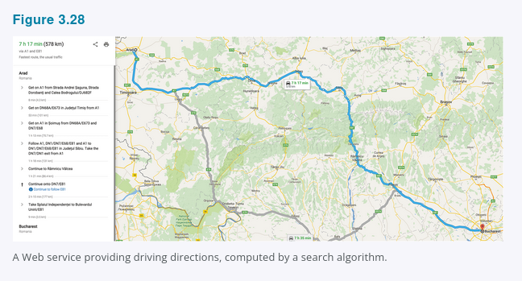
3.6.4 · FIGURE 3.28
Generating heuristics with landmarks
Online map services hold graphs with tens of millions of vertices and return cost-optimal driving directions in milliseconds — roughly a million times faster than the best algorithms we have covered. How?
THE ANSWER: PRECOMPUTATION
Precompute some optimal path costs. It is time-consuming, but it happens once and is amortised over billions of user queries.
WHY NOT PRECOMPUTE EVERYTHING?
A perfect heuristic would store the optimal cost between every pair of vertices: O(|V|²) space and O(|E|³) time. Practical at ten thousand vertices. Hopeless at ten million.
Instead choose perhaps 10 or 20 landmark points, and for each landmark L and every vertex v store the exact optimal cost C*(v, L) — and C*(L, v) too, if the graph is directed:
h_L(n) = min over L in Landmarks [ C*(n, L) + C*(L, goal) ]
COMP 469 · AIMA 3.5–3.6
53
Notes:
[2:30-2:34] Landmarks.
Open with the puzzle: our best algorithm searches maybe a hundred thousand nodes per second, and the graph has ten million vertices, yet the answer comes back instantly. Something other than search is happening.
The all-pairs calculation is worth stating explicitly so the landmark idea feels forced rather than arbitrary. Ten million vertices squared is 10^14 entries. Not happening. Twenty landmarks times ten million vertices is 2 × 10^8 entries - large but entirely ordinary.
The hL formula: to estimate the distance from n to the goal, route through a landmark and take the best such route. If the true optimal path happens to pass through a landmark, this is EXACT. Otherwise it overestimates - so it is inadmissible. Next slide fixes that.
Mention shortcuts here: artificial edges representing optimal multi-action paths. With shortcuts between the 100 biggest US cities, a Berkeley-to-NYU query covers 90 percent of the distance in a single action.

Slide 54
3.6.4
The differential heuristic, and choosing landmarks
h_L is efficient but inadmissible. With a little more care we can have both efficiency and admissibility:
h_DH(n) = max over L in Landmarks | C*(n, L) − C*(goal, L) |
WHY THE SUBTRACTION WORKS
WHICH LANDMARKS ARE USELESS
Picture a landmark somewhere out beyond the goal. If the goal lies on the optimal path from n to that landmark, then taking the whole path n→L and subtracting the tail goal→L leaves exactly the cost from n to the goal.
When the goal is a little off that path, the estimate is inexact — but still admissible.
A landmark that is not out beyond the goal contributes little. A landmark exactly halfway between n and the goal gives h_DH = 0 — the two distances cancel, and you learn nothing.
For the differential heuristic, spread landmarks around the perimeter of the graph.
Four ways to pick landmark points:
Method
How it works
Random
Fast, but landmarks may cluster and duplicate one another's information
Greedy farthest-point
Pick one at random, then repeatedly add the vertex maximising distance to the nearest existing landmark
Query logs
If you have logs of past user searches, use frequently requested destinations
Pie wedges
Find the graph's centroid, arrange k wedges around it, take the farthest vertex in each
COMP 469 · AIMA 3.5–3.6
54
Notes:
[2:34-2:37] Differential heuristics and landmark selection.
The absolute-difference formula is easier to believe with a straight-line picture on the board: put n, then goal, then L collinear. C*(n,L) minus C*(goal,L) is literally the segment from n to the goal. Now nudge the goal off the line and the difference shrinks - which is fine, because shrinking means underestimating, which means admissible.
The halfway-landmark case is the intuition pump for landmark placement: if C*(n,L) equals C*(goal,L), the difference is zero and the heuristic tells you nothing. Useful landmarks are ones where n and the goal are at very different distances.
Close with the reason landmarks work so well specifically on road networks: a great deal of traffic genuinely wants to travel between landmarks, so civil engineers built the widest and fastest roads along exactly those routes. Landmark search recovers the routes the road system was designed around. That is a lovely example of domain structure paying off.

Slide 55
3.6.5 · THE METALEVEL STATE SPACE
Learning to search better
Every algorithm so far was designed and programmed by a human. Could an agent learn to search better? Yes — and the idea rests on distinguishing two state spaces.
OBJECT-LEVEL STATE SPACE
METALEVEL STATE SPACE
The problem itself — the map of Romania.
States are cities. Actions are roads.
This is what we have been searching all along.
The internal computational state of the program doing the searching.
A state is the current search tree. An action is one computation step — expanding a leaf and adding its successors.
Figure 3.18 — the sequence of ever-larger A* search trees — is itself a path through the metalevel state space. Each object-level search tree is one metalevel state.
That path has five steps, and one of them — expanding Fagaras — was not especially helpful. On harder problems there are many such missteps.
A metalevel learning algorithm learns from those experiences to avoid exploring unpromising subtrees. The techniques are covered in Chapter 22.
The objective is to minimise total cost: computational expense traded off against path cost.
COMP 469 · AIMA 3.5–3.6
55
Notes:
[2:37-2:40] Metalevel learning.
The level distinction trips people up, so make it very concrete. Object level: 'I am in Sibiu, I could drive to Fagaras.' Metalevel: 'my search tree currently has nine nodes and I am deciding whether expanding Fagaras is worth the CPU time.'
Point back at Figure 3.18 if it is still accessible - each of the six panels is a single state in the metalevel space, and the arrows between panels are metalevel actions. That reframing usually makes it click.
The Fagaras expansion is the concrete waste: in hindsight it contributed nothing to finding the optimal path. An agent that had learned from thousands of Romania-like problems might have skipped it.
Note the objective function change. Ordinary search minimises path cost. Metalevel reasoning minimises path cost PLUS computation. That is a different and more honest objective, and it is where Chapter 22 picks up.

Slide 56
3.6.6
Learning heuristics from experience
One way to invent a heuristic is to relax the problem. Another is to learn from experience — where experience means solving a great many instances. Each optimal solution provides an example (state, true cost) pair.
RAW STATES ARE HARD TO LEARN FROM
TWO FEATURES FOR THE 8-PUZZLE
Most learning methods do better when given features of a state that are relevant to predicting its heuristic value, rather than the raw board.
x₁(n) = number of misplaced tiles. Gather statistics over 100 random configurations: when x₁ = 5, the average true solution cost is around 14.
x₂(n) = number of pairs of adjacent tiles that are not adjacent in the goal state.
h(n) = c₁ x₁(n) + c₂ x₂(n)
Fit c₁ and c₂ to the observed solution costs across the randomly generated configurations. Both should come out positive — misplaced tiles and broken adjacencies both make a puzzle harder.
This heuristic does satisfy h(n) = 0 at goal states, but it is not necessarily admissible and not necessarily consistent.
So there is an unavoidable three-way tradeoff: learning time, search run time, and solution cost. Chapter 19 covers the learning techniques; the reinforcement learning of Chapter 22 also applies to search.
COMP 469 · AIMA 3.5–3.6
56
Notes:
[2:40-2:43] Learning heuristics.
Frame this as the fourth and most modern source of heuristics, after relaxation, pattern databases, and landmarks.
The feature point is worth dwelling on because it generalises far beyond search: learning from raw state representations is hard; learning from well-chosen features is much easier. Chapter 19 makes this formal, and deep learning is largely the story of learning the features too.
x2 is a good feature to explain concretely - two tiles that sit next to each other but should not is a signal that a rotation is required, which costs several moves. Manhattan distance cannot see that; it treats every tile independently.
The admissibility loss is the important caveat and ties the section together: almost every learned heuristic is inadmissible, which means A* with a learned heuristic is a satisficing search, not an optimal one. That is usually an acceptable trade, and it is exactly the trade we studied in 3.5.4.

Slide 57
3.6 · SUMMARY
Where heuristics come from — the four sources
Source
Mechanism
Admissible?
Cost you pay
Relaxed problems
Delete preconditions from the action rules; solve the easier problem exactly
Yes — and consistent
Relaxed problem must be solvable without search
Pattern databases
Solve a subproblem exactly for every configuration; store and look up
Yes
Memory and offline precomputation
Disjoint pattern DBs
Count only moves of the tiles in each group, so groups can be summed
Yes
Requires a domain that decomposes cleanly
Landmarks (h_L)
Route through a precomputed landmark and take the minimum
No
Optimality is lost
Differential (h_DH)
Take the maximum absolute difference of landmark distances
Yes
Landmarks must be placed beyond the goal
Learning from experience
Fit a function to features of solved instances
Usually not
Training time; optimality is lost
Every one of these is an attempt to raise h toward h* without making it expensive — which, by the domination result, is the only lever that matters.
COMP 469 · AIMA 3.5–3.6
57
Notes:
[2:43-2:46] Summary of 3.6. Another slide students will photograph.
Read down the Admissible column. Four yeses and two noes, and the two noes are both the modern, practical techniques - landmarks as used by real map services, and learned heuristics. That is not a coincidence. At production scale, people give up the optimality guarantee.
Ask the class which row they would reach for first on a brand new problem. The right answer is usually relaxation: it is free, it requires no precomputation, and it gives you consistency. Pattern databases come next if you will solve many instances of the same problem.

Slide 58
CHAPTER 3.5–3.6
Key takeaways
1
One algorithm, many faces
2
A* is optimal because h is optimistic
Best-first search with different evaluation functions gives BFS, uniform-cost, greedy, A*, and weighted A*. Name the f and you have named the algorithm.
Admissibility (h ≤ h*) gives cost-optimality. Consistency (h(n) ≤ c + h(n′)) is stronger, is checkable locally, and is what makes the contour picture true.
3
Never goal-test on generation
4
Memory, not time, is what breaks A*
Step (e) of Figure 3.18 returns 450 instead of 418 if you do. A node on the frontier is a promise, not a solution.
Beam, IDA*, RBFS and SMA* each trade something — completeness, optimality, or re-expansion time — to fit in the memory you have.
5
Heuristic quality is the whole game
6
Optimality is negotiable
Domination: a larger admissible heuristic never expands more nodes. Relaxation, pattern databases, landmarks and learning are four ways to get one.
Weighted A*, beam search, landmarks and learned heuristics all give it up on purpose — in exchange for solutions you can actually compute.
COMP 469 · AIMA 3.5–3.6
58
Notes:
[2:46-2:50] Takeaways. Read the six headers aloud; let the bodies be reference material.
If you are short on time, takeaways 2, 3 and 5 are the ones that carry the most exam weight and the most practical weight. Takeaway 3 in particular is the one that shows up as a bug in student implementations.
Invite questions here rather than on the final slide, so the logistics slide is the last thing on screen as people pack up.

Slide 59
BEFORE NEXT SESSION
What to review
Re-derive the A* optimality proof from scratch, without notes. Five lines.
Trace Figure 3.18 yourself and be able to say why the goal was rejected at step (e).
Work Exercise 3.GASC: what heuristic comes from relaxing only the adjacency condition?
Be able to state, for each algorithm in 3.5, its f, its space complexity, and what it gives up.
Read the chapter summary — it is the best one-page revision sheet you will get.
Next: Chapter 4 — Search in Complex Environments
Local search, nondeterministic actions, partial observability — what happens when the tidy assumptions of Chapter 3 fail.
COMP 469 · AIMA 3.5–3.6
59
Notes:
[2:50-2:55] Logistics and close. Leave this up while students file out.
Chapter 3 assumed the environment was episodic, single-agent, fully observable, deterministic, static, discrete, and completely known. Chapter 4 removes those assumptions one at a time. Preview it in one sentence so they see why the next unit exists.
If any checkpoint answers were skipped for time, point students to the speaker notes or post them separately.

